Slide 1



Smart Choices
CHECKLIST

Slide 2
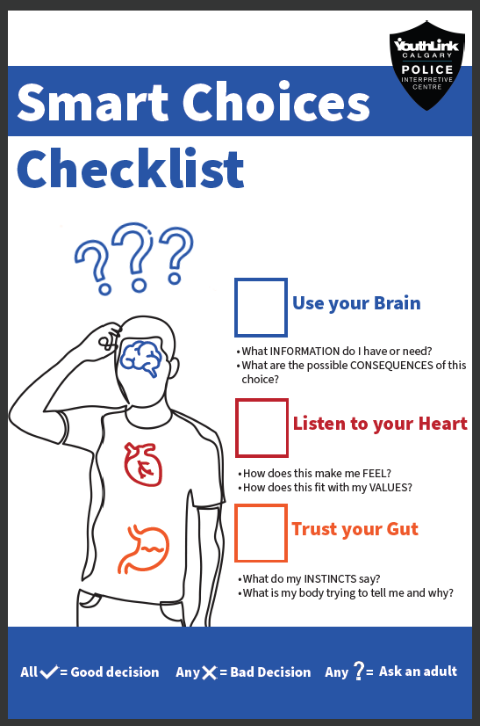
Have you ever been told to “make good choices”?

Slide 3

Smart Choices Checklist
Use your
Listen to your
Trust your

Slide 4

Use your Brain
What INFORMATION do I have or need?
What are the possible CONSEQUENCES of this choice?

Slide 5

Listen to your Heart
How does this make me FEEL?
Does it fit in with my VALUES?

Slide 6

Trust your Gut
What are my INSTINCTS telling me?
What is my BODY trying to tell me? Why?

Slide 7



All
Good decision
Any
Bad decision
From who?
Any
Ask for help

