Slide 1


CYBER SAFETY
Post Program Lesson

Slide 2


Passwords
With all of the technology that is used in our everyday lives, stolen passwords and hacking are common dangers that we can take steps to protect ourselves from!
Choosing a safe and secure password is very important for our protection. Often, an individual may choose to use a simple word, phrase or number that is easy to remember, for all of the different accounts that they access.
Do you think that is safe?

Slide 3
Passwords
Can you guess some of the most common passwords that are used in the world?
1. 123456
2. 123456789
3. qwerty
4. password
5. 1234567
6. 12345678
7. 12345
8. iloveyou
9. 111111
10. 123123
Do you think that these passwords would be easy to guess, or hack?

Slide 4
How safe is your password
Before we learn about how to make our passwords safe, ask yourself the following questions (you do not need to share your answers out loud!):
  Do you use the same password for more than one account?
  Do your passwords use any important details about your life, such as a birthday, place, or family member’s name?
  Have you written your passwords down somewhere to remember them?

Slide 5
How safe is your password
The following are some important and helpful tips about how we can make our passwords safe, secure, and easy to remember!
  Your password should be unique for each account that you access.
  Passwords should not contain any personal information or important details about your life.
  You should not tell anyone your passwords or write them down, except a safe and trusted adult such as a parent or guardian.
  Passwords should be long, and use random symbols, letters, and numbers to make them more secure.
The following are some important and helpful tips about how we can make our passwords safe, secure, and easy to remember!

Slide 6
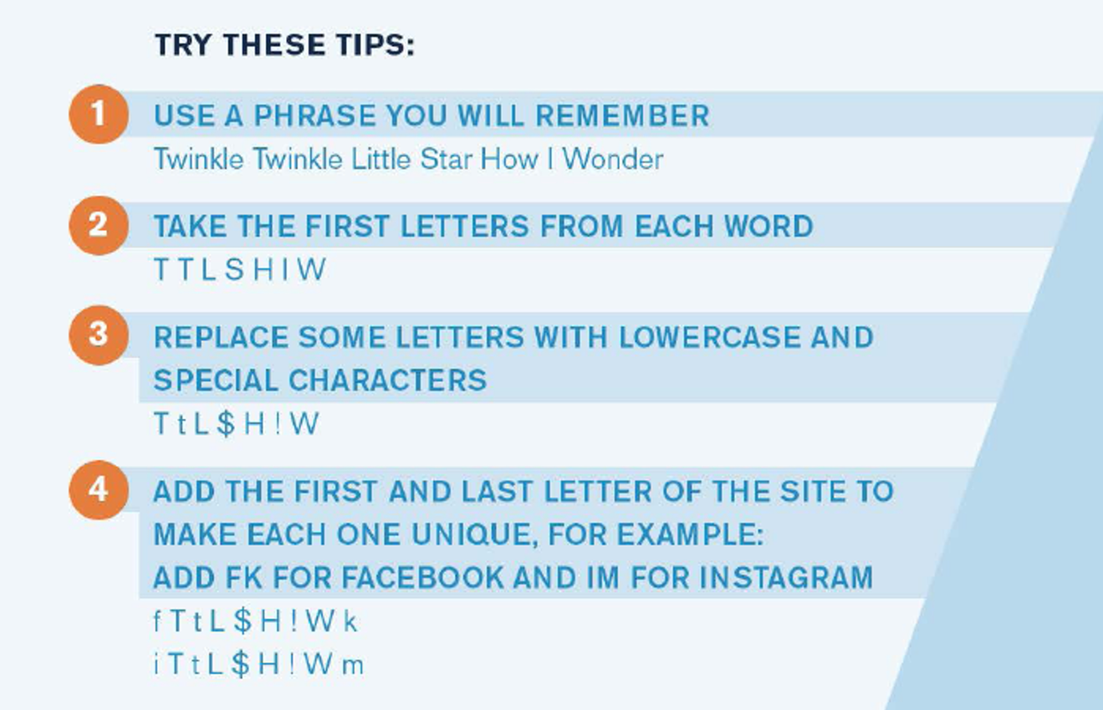
Creating a password

Slide 7
Let’s practice
Take out a piece of paper and a pencil, and practice making a password using this strategy.
1.Write down a phrase you will remember (such as a song, or rhyme)
2. Write down the first letter of each word in that phrase
3.Replace some of those letters with special characters and lower case
4.Add a letter at the beginning and end of your phrase to represent a website or app you may use the password for (ie: “I” and “m” for Instagram)

